Slide 1
Version Control with Git
Matt Critchlow - UC San Diego Library
Notes:
Start here!

Slide 2
Reminders
Git installation and Github account
Sticky Notes!
Etherpad
Questions? 1. Etherpad 2. Ask TA 3. Ask me!
Notes:
Does anyone NOT have git installed and a Github account?
Sticky Notes: Yellow = good! Pink = HELP!
Please ask general questions at any time. However, if you’re stuck on something with an exercise or command, please try and get the attention of a helper.
Next slide ->

Slide 3
What are we covering?
What is version control?
Essential Git commands
Collaborating with Github
Notes:
So today we’re going to cover (read)
First we’re going to discuss version control. Git is a free and open source distributed version control system. We all know what free means, and I suspect many of you have a sense of what open source means as well. But how about the distributed version control system part?
Well, let’s first look at the kind of problem that version control systems were built to address, and then we’ll talk about what makes Git a distributed system
Next slide ->

Slide 4
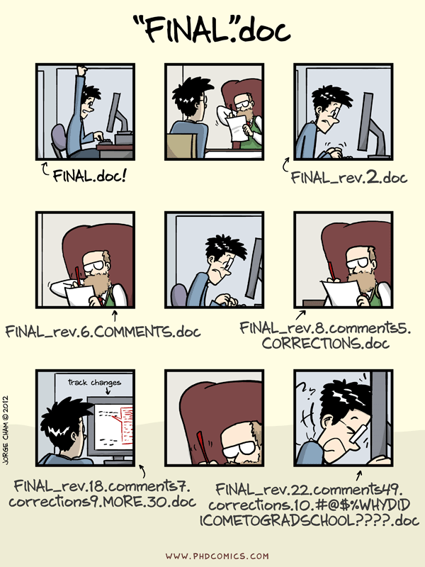
Notes:
Does this look familiar? Of course it does. We’ve all been subject, willingly and not, to this exercise.
You start off with good intentions, creating one document. But you need feedback, you have collaborators, or at some point you want to try out a new idea and make a copy of your document with that name.
Automated version control can get you out of this situation by letting us work on the same file but create unique versions in which only the changes are stored. We’ll get into this more in a bit. But first you might be saying to yourself, but these idiots should have been using Microsoft track changes!
Well, Microsoft Word does have track changes, but that’s just for Word documents, and I’ve seen plenty of examples where track change documents still get renamed by people. Google Docs does indeed have version history, but, again, you’re in a single silo’d context of Google Docs.
A version control system is file agnostic.
So, let’s take a closer look at how version control systems handle changes
Next slide ->

Slide 5

Changes Saved Sequentially
Notes:
Version control systems start with a base version of the document and then save just the changes you made at each step of the way, as well as important metadata about those changes, such as who made them.
You can think of it as a tape: if you rewind the tape and start at the base document, then you can play back each change and end up with your latest version. Contrast this with the kind of workflow we saw on the previous slide, where each new named copy of the file is a complete copy. This significantly saves a ton of space!
Next slide ->

Slide 6
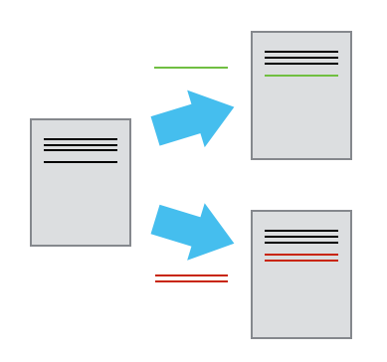
Divergent Versions
Notes:
Once you think of changes as separate from the document itself, you can then think about “playing back” different sets of changes onto the base document and getting different versions of the document.
For example, two users can make independent sets of changes based on the same document.
Next slide ->

Slide 7
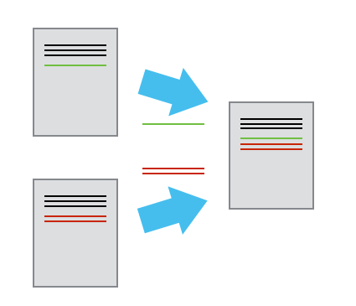
Merging
Notes:
If and when you and your collaborator want to merge work work back together, you can even try to play two sets of changes onto the same base document
If your changes are independent (separate areas of a file in this case) they can be merged back into a single document. If they’re in the exact same area of the document, then you can still merge the changes back in, but you’ll have to pick which of the changes you want. Git has tools to help you do this.
Next slide ->

Slide 8
Brief Glossary
Version Control - A tool for managing changes to a set of files. Each set of changes creates a new commit of the files; the version control system allows users to recover old commits reliably, and helps manage conflicting changes made by different users.
Commit - To record the current state of a set of files (a change set) in a version control repository
Repository - A storage area where a version control system stores the full history of commits of a project and information about who changed what, when.
Merge - To reconcile two sets of changes to a repository
Notes:
That was a lot!
Ok, so to circle back before we start on the command line, I always find it helpful to make sure we’re all speaking the same language. Everyone is used to coming into a new environment where people are using crazy acronyms and terms that are highly domain specific. I mean we work in a Library for god sakes. So, here are some terms and definitions we’re going to use going forward.
A version control system is a tool that keeps track of these changes for us and helps us version and merge our files. It allows you to decide which changes make up the next version, called a commit, and keeps useful metadata about them. The complete history of commits for a particular project and their metadata make up a repository. Repositories can be kept in sync across different computers facilitating collaboration among different people.
Questions?
Next slide ->

Slide 9
DVCS vs VCS
VCS - Version Control System - CVS, Subversion, RCS
DVCS - Distributed Version Control System - Git, Mercurial
Notes:
OK, so now we’ll circle back to what makes git a distributed version control system.
VCS is a traditional version control system. In this model, a repository was stored in a single, centralized, server. If you want to see history, checkout a project, or do most anything, you need to be online connected to the server. Basically every workflow action is dependent on the server. You can think of this in a similar way as being connected to a shared network drive. The only way you can interact with the contents of the network drive is to have it mounted with a live connection. You can’t work “offline”.
With a DVCS system like Git, your copy of the repository is complete, with no dependencies on any external servers. If you have a copy of the repository on two of your personal computers, say a laptop for travel and a desktop at work, each of those copies are complete copies of the repository. Hence the term distributed. You can commit locally, on a plane without wifi, or in the Library right now if the wifi dies. You can merge your changes down the road, whenever you want. For those who have used Dropbox, it’s similar to a distributed system in comparison to the shared network drive.
We use Git for the library and software carpentry courses because of the prevalence of use. It is the most widely used VCS by far.
Ok, enough talk, let’s git to the command line! Sorry, had to.
Back to slides (Setting up Git) ->

Slide 10
Challenge: Committing Changes to Git
Which command(s) below would save the changes of myfile.txt to my local Git repository?
$ git commit -m “my recent changes”
$ git init myfile.txt -> $ git commit -m “my recent changes”
$ git add myfile.txt -> $ git commit -m “my recent changes”
$ git commit -m myfile.txt “my recent changes”
Notes:
Time: 3 minutes.
Answer: (3)
Question: Who would like to talk a little more about the difference between git add and git commit before we keep moving on? (If yes, next slide. If no, back to printout)
Next slide ->

Slide 11
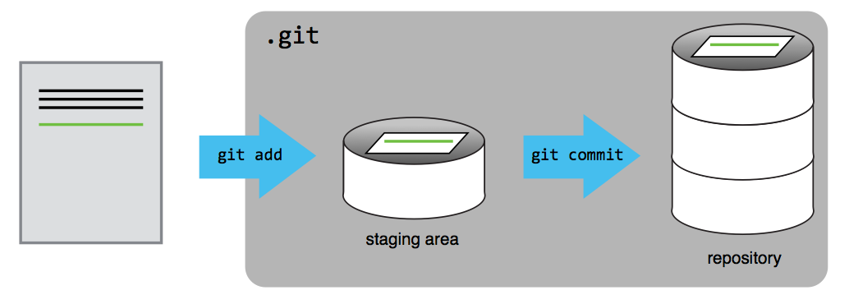
Git Staging Area
Notes:
You might think it’s a bit annoying to have to add your changes to a staging area, then commit them
A commit represents a set of work, changes/additions/deletions of one to many files.
Many times, you might find yourself touching several files as part of a change. Maybe you update a script and the documentation in a README, for example.
Add files as you work on this, then when everything is ready, you can review (using our favorite git status) and then commit
Shopping cart metaphor. Your staging area is the shopping cart. You walk the aisles in the store and grab what you need for the dinner you’re making tonight. But at the end of all that shopping, you checkout once for everything
Also lets you catch mistakes and fix them, or make additional changes, before you commit
Let’s look at another example with multiple files (next slide)

Slide 12
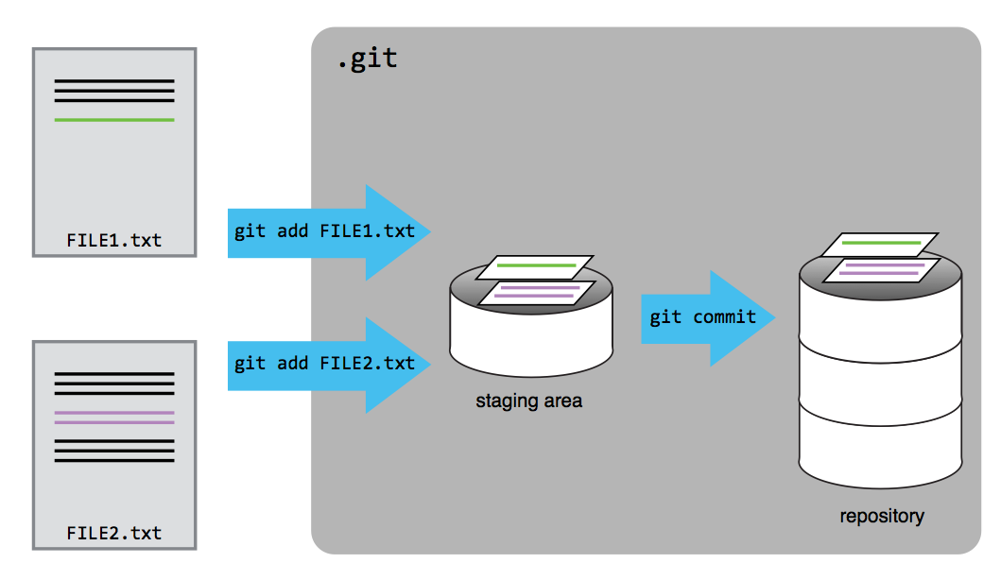
Git Staging Area (multiple files)
Notes:
Explain this in time sequence. I might edit and add file 1 this morning, sit through a git class, then come back and add file 2 later
Then, when I’m ready, I can commit
QUESTIONS?
Back to Notes -> (Let’s watch staging area line)

Slide 13
Challenge: Tracking Changes
Document two additional git commands that we’ve discussed to your basics.md
There are three to choose from: git commit, git diff, git log
Commit your changes
Modify the description of one of the commands
Now and document the third remaining command
Display the differences between its updated state and its original state
Commit your changes
View your version history to confirm
Notes:
Green stickies when you’re done. Red if you need help from a TA.
BREAK?
Back to notes (Exploring History)!

Slide 14
Challenge: Recovering Older Versions of a File
$ git checkout HEAD
$ git checkout HEAD data_cruncher.py
$ git checkout HEAD~1 data_cruncher.py
$ git checkout <unique ID of last commit> data_cruncher.py
Both 2 and 4
Notes:
Which commands below will let you recover the last committed version of her Python script called data_cruncher.py?
If you don’t know immediately, or aren’t sure please take the time to simulate this yourself in a separate directory. When you’re done and think you have the answer, please use your green sticky.
Answer: 5 (2 and 4)
Let’s look at a visual of history (next slide)

Slide 15
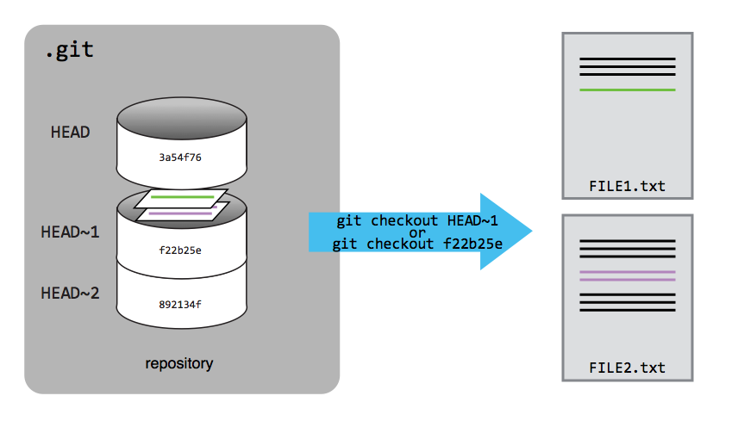
Exploring History
Notes:
It’s important to remember that we must use the commit number that identifies the state of the repository before the change we’re trying to undo. Otherwise, you’ll have to manually undo (or retype) the change, which defeats the purpose.
A common mistake is to use the number of the commit in which we made the change we’re trying to get rid of. In the example below, we want to retrieve the state from before the most recent commit (HEAD~1), which is commit f22b25e. So we can use HEAD~1 (which I would generally recommend) or checkout using the short key.
Back to Notes (Remotes in Github!

Slide 16
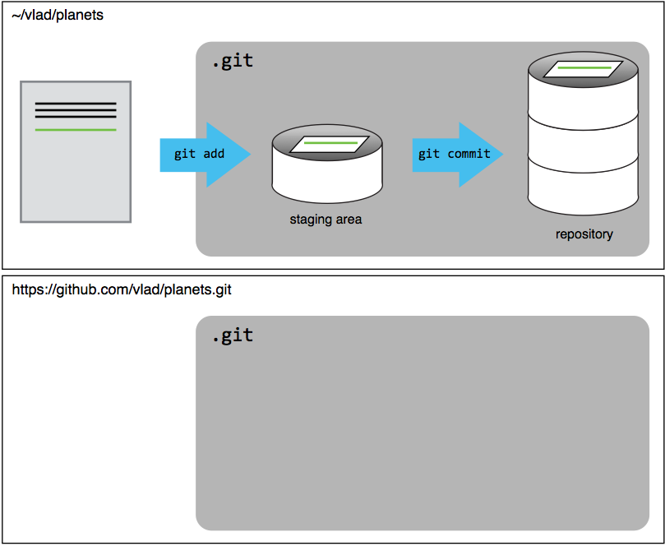
New Github Repository - Existing Project
Notes:
Our local repository still contains our work on basics.md, but the remote repository on Github doesn’t contain any files yet
We have the remote setup, but we haven’t actually sent any content to our remote repository. Let’s do that now
Back to notes

Slide 17
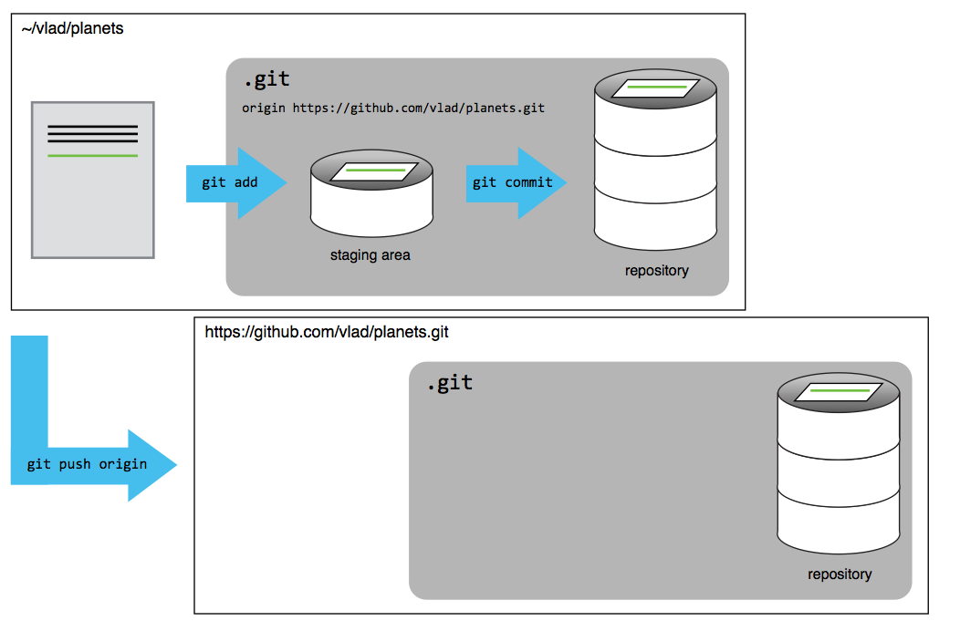
Github Remote Repository Populated
Notes:
Our local and remote repositories are now in the same state. Our remote ‘origin’ Github repository has a complete copy of our local repository.
Back to notes

Slide 18
Challenge: Github GUI
Browse to your git-basics repository on Github. Under the Code tab, find and click on the text that says “XX commits” (where XX is some number). Hover over, and click on, the three buttons to the right of each commit.
What information can you gather/explore from these buttons? Discuss with folks at your table.
Notes:
Maybe skip this if time is running short
Copy the SHA1 unique ID, View the complete commit with changes, See the entire repository at that specific commit
a) git rev-parse HEAD (HEAD~1, etc.). To copy to clipboard you can | pbcopy (mac) or | clip (windows)
b) git diff HEAD..HEAD~1
b) git checkout commit_id (HEAD~X). Then go back via git checkout master (or original branch)
There is also an advanced version of the shell commands that we can explore at the end if folks are interested. Involved traversing the git repository itself. Remind me!
git cat-file <first seven of commit> (actual commit stored, pointer to tree (hierarchy) and parent (directed acyclic graph, so this is the pointer to previous version). Merged commit has 2 parents!
Git ls-tree <first seven of tree from object cat-file> - this is the content
Git cat-file <first seven of blog from blob in ls-tree> - actual file content
Next slide ->

Slide 19
Push vs. Commit
In this lesson, we introduced the ‘git push’ command.
How is ‘git push’ different from ‘git commit’?
Notes:
Commit records changes to the local repository.
Push updates a remote (non-local) repository with your commit(s).
Back to Notes (Collaborating) ->

Slide 20
Challenge: Review changes
The Owner push commits to the repository without giving any information to the Collaborator.
How can the Collaborator find out what has changed with the command line? And on Github?
Notes:
Shell : quick version: git pull. Long version: git fetch origin, git diff HEAD origin/master
Github : Depends. Can look at commits log and look back to your last commit in repo. Other ideas from TA’s?
Back to notes “Comment changes in Github”

Slide 21
Challenge: Solving Conflicts that you Create
Switch roles for creating a conflict. If the Owner created the conflict last time, have the collaborator do so this time.
Add a new file to the repo with content of your choice
Both pull latest copy
Switch role of who commits conflicting changes first
Resolve merge conflict after git pull
Push changes back to repository
Have other teammate pull merged change and confirm
Notes:
Next slide ->

Slide 22
Conflicts on Non-textual files
What does Git do when there is a conflict in an image or some non-textual file that is stored in version control?
Notes:
Do a little research as a team. Mark your stickies green when you have an answer.
Git actually can do diffing on binary files. As a general rule, you’ll likely end up picking the file you want, rather than actually resolving “merge conflicts”
That said, let’s look at what Github is doing with image diffing: https://help.github.com/categories/working-with-non-code-files/
It’s safe to say additional filetypes will follow as they gain enough traction. My personal dream is to see this for CSV files!
If done, go to http://swcarpentry.github.io/git-novice/10-open.html and have them read https://guides.github.com/activities/citable-code/
Then just follow other lessons as time allows via swcarpentry site (license, citation, hosting) ( I will be doing a talk at Campus LISA with Bill Decker about Licenses for open source content
IF get past all that, do a demo of forking a repo (have a student fork my plants repo), then making a change and doing a PR

Slide 23
Discussion: Git(hub) at SIO?
Library Use of Github
Software Carpentry Courses!
Software applications
Development Team Guides
Github issues w/ ZenHub
Metadata?
Government: https://government.github.com/community/
Programming Historian: https://github.com/programminghistorian/jekyll
Notes:
What can you all think of that might benefit from using version control, specifically using git and Github?
Here are some of the things we’re using it for now at the Library as well as some other ideas I’ve seen.
a few other examples of non-programmer related uses came up here recently: a journal is using it for the editorial process and, if I remember correctly, some government agency is using it to collect feedback on the text of proposed revision to some regulation (or something)
Github has a built in ticketing system as well and recently introduced Github Projects. Now you can create your own project board, manage the state of your tickets, etc.
UCSB - using it to track changes to their metadata of their digital collections and triggers ingest and updates.
Government agencies at the national, state, and local level use GitHub to share and collaborate. Some of this is code, documentation, surveys, websites.
The Programming Historian offers novice-friendly, peer-reviewed tutorials that help humanists learn a wide range of digital tools, techniques, and workflows to facilitate their research.
Next Slide ->

Slide 24
Discussion: Git(hub) at SIO?
Break into groups of X
Discuss and identify a possible use of Git/Github at work
Discuss and identify the most important thing about version control, Git, or Github that you still have a question about
Notes:
IF TIME PERMITS: BREAK INTO GROUPS
(identify a possible use of Github/Git at work and one thing about Git or version control you still have a question about). We’ll read as a class.
10 minutes?
Go around and read.
If I can answer Git question, I will, if not, I’ll follow up after class with pointers in the notes

Slide 25
Using Git: Alternatives to Command Line
GitK: https://git-scm.com/docs/gitk
Github Desktop: https://desktop.github.com/
Atlassian SourceTree: https://www.atlassian.com/software/sourcetree
GUI Clients: https://git-scm.com/downloads/guis
Editor Git Integrations: R Studio, Atom, Sublime Text, Vim, emacs, ...
Notes:
In this class, we’ve taught you the core basic usage of git on the command line, since the rest of the work we’re doing is primarily in a command line workflow.
That said, I know many of you do not use the command line on a daily basis, though hopefully you will consider it more going forward.
There are more user-friendly desktop client applications that you can use instead of the command line.
Github Desktop is great if you’re working with Github, highly recommended.
SourceTree is built by Atlassian. If you use their Stash product, you may decide you prefer SourceTree as there are some nice Stash integrations.
Most editors also have some form of Git integration now as well. It’s worth looking to see if you have a favorite editor.

Slide 26
Resources
http://swcarpentry.github.io/git-novice
http://swcarpentry.github.io/git-novice/reference.html
https://services.github.com/kit/downloads/github-git-cheat-sheet.pdf
http://ndpsoftware.com/git-cheatsheet.html
https://help.github.com/articles/dealing-with-line-endings/#platform-all
https://help.github.com/articles/generating-an-ssh-key/ (SSH keys)
https://www.youtube.com/watch?v=dBSHLb1B8sw (Deep Dive into Git)
https://git-man-page-generator.lokaltog.net/ (Fun with Git Docs)

